Slide 1

ChromAlyze
Your solution to understand your risk of developing coronary heart disease

Slide 2
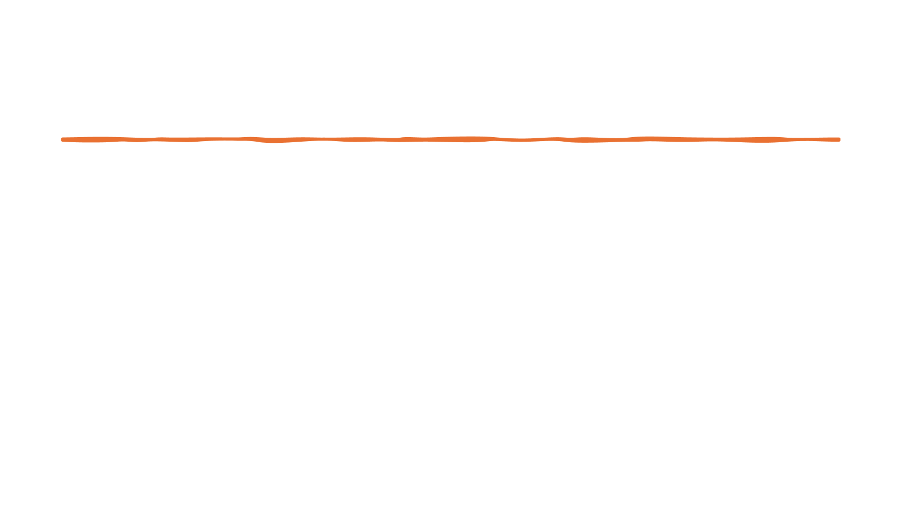
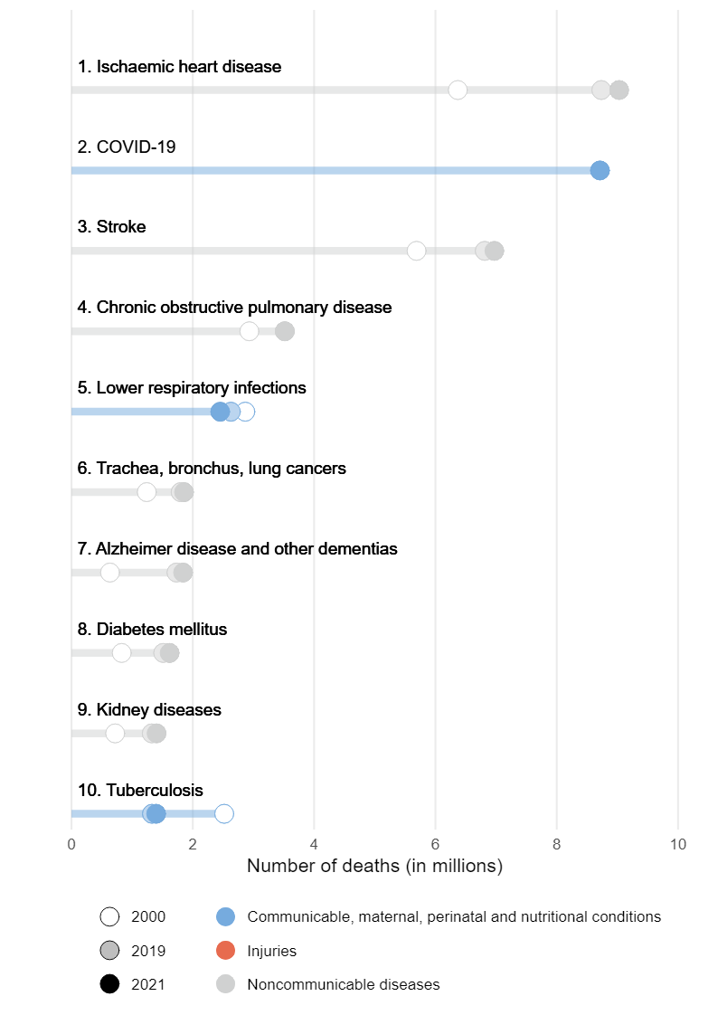
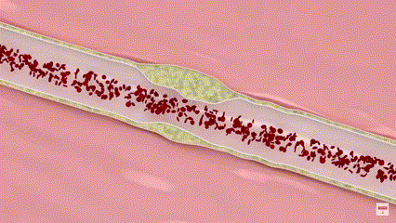
Problem coronary heart disease
Leading cause of death
Multifactorial disease
High medical cost
Current solutions?
https://www.who.int/news-room/fact-sheets/detail/the-top-10-causes-of-death
https://www.youtube.com/watch?v=SVTScKUGogc
Notes:
Current solutions are not …

Slide 3


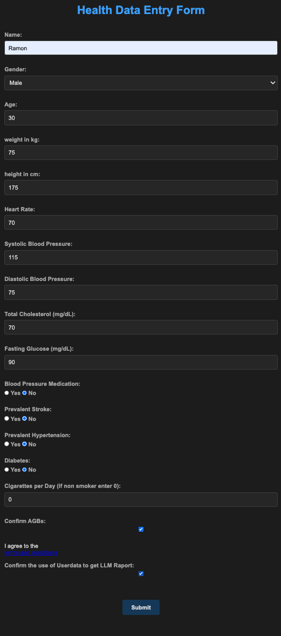
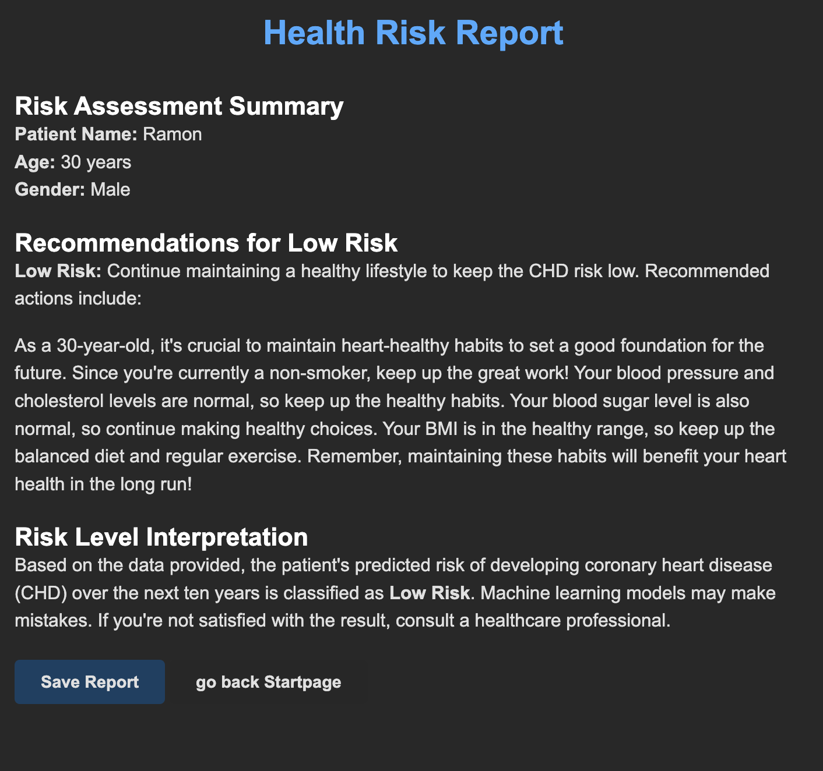
Solution
Web app
Machine learning with personalized evaluation
Educate users on risk factors and offer recommendations.
Accessible on mobile devices
Notes:
2. Solution
Objective: Describe your proposed or implemented approach to address the problem.
Key Points:
What is the solution? (Provide a brief summary.)
How does it work? (Outline its core principles or mechanics.)
Why is it better than alternatives? (Highlight unique benefits or advantages.)
Is it feasible? (Demonstrate that the solution is practical, scalable, or affordable.)

Slide 4
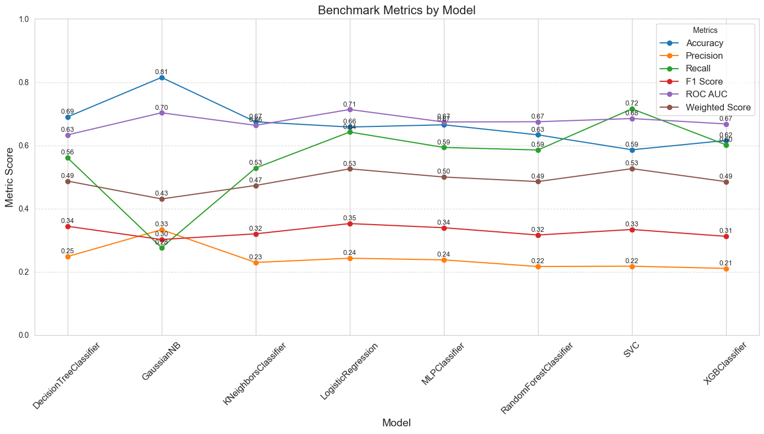
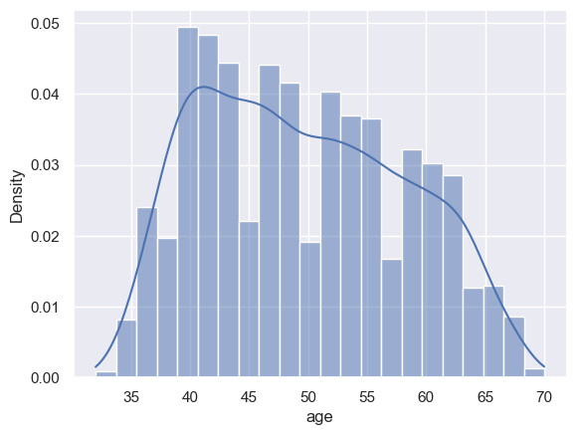
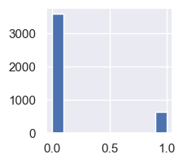
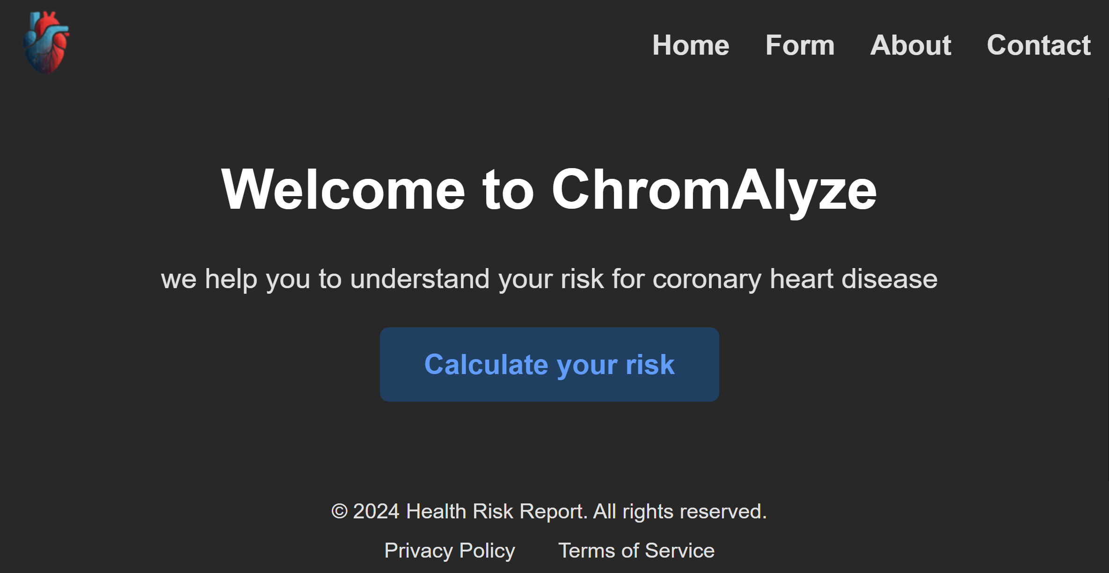

Methods
Exploratory data analysis
Benchmarking different ML algorithms
LLM for personalized recommendation
Flask app
Target
hyperparmeter tuning
Weighted Score for model selection
Handling missing data
Adress class imbalance
«Consider stop smoking,
it has a big impact on
Health.»
Webapp form
Predict risk with pre-trained model in app
Included in app
Optimized prompt engineering
https://huggingface.co/brand

Slide 5
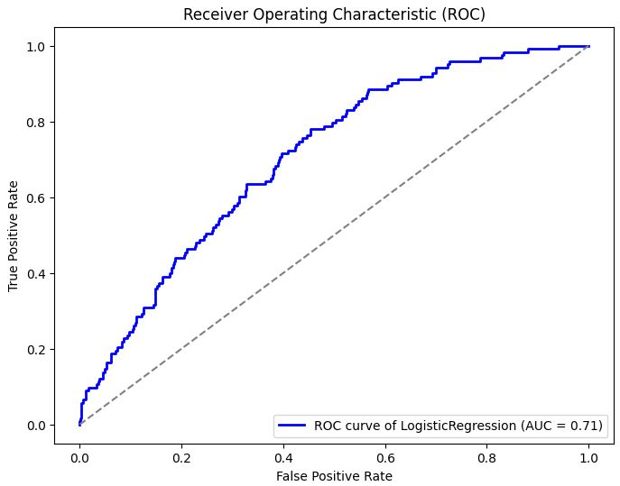
Results
Accuracy | Precision | Recall
0.67 | 0.25 | 0.63
F1- Score
0.35

Slide 6
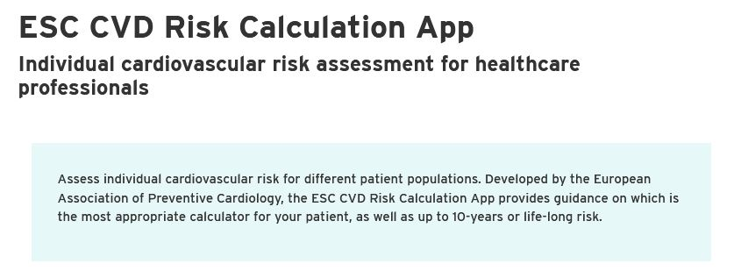

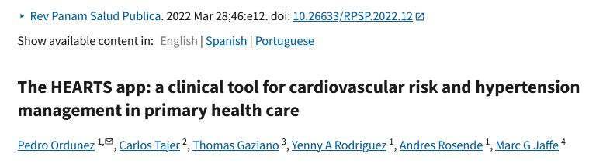

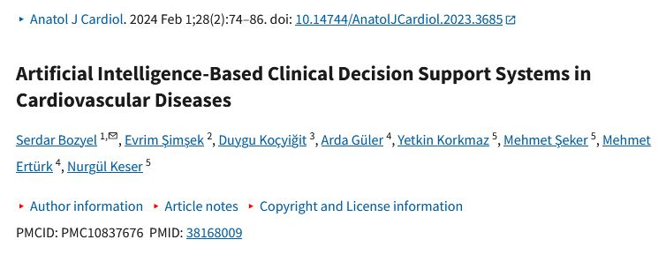
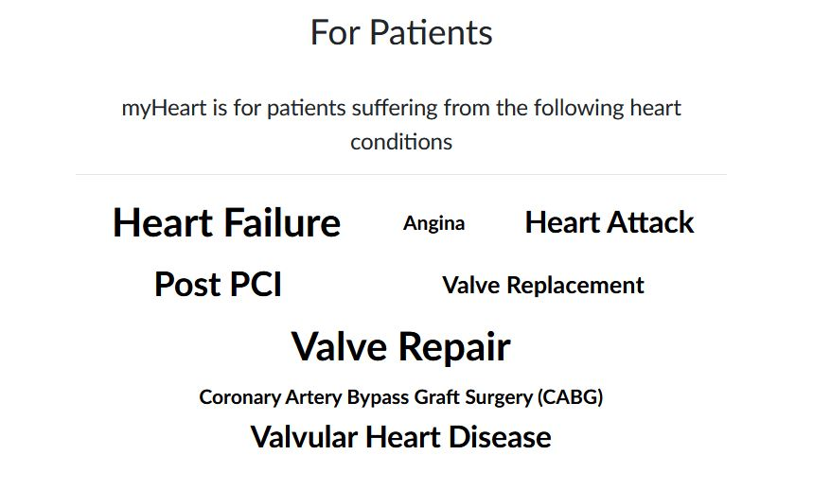
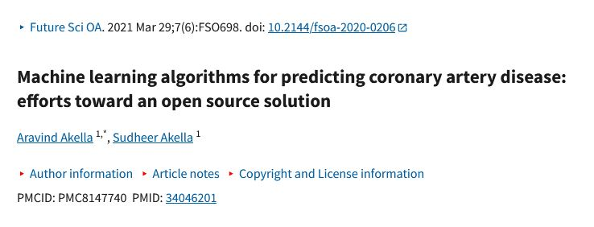
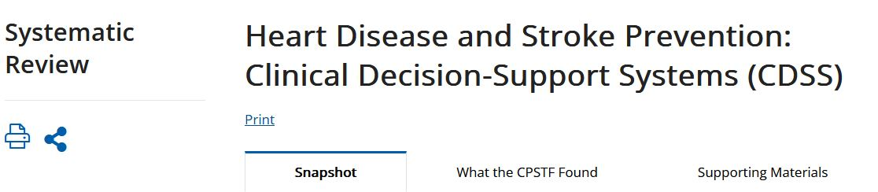
Impact
Tool for citizen
Realise lifestyle changes
First line of defense
Decrease healthcare cost
Be aware of own risk
Increase heart health
https://mymhealth.com/myheart
https://www.escardio.org/Education/ESC-Prevention-of-CVD-Programme/Risk-assessment/esc-cvd-risk-calculation-app
https://www.thecommunityguide.org/findings/heart-disease-stroke-prevention-clinical-decision-support-systems-cdss.html
https://www.thelancet.com/journals/lancet/article/PIIS0140-6736(22)02079-7/abstract
https://www.management-krankenhaus.de/news/ein-potenzieller-zusammenhang-zwischen-herz-und-hand

Slide 7
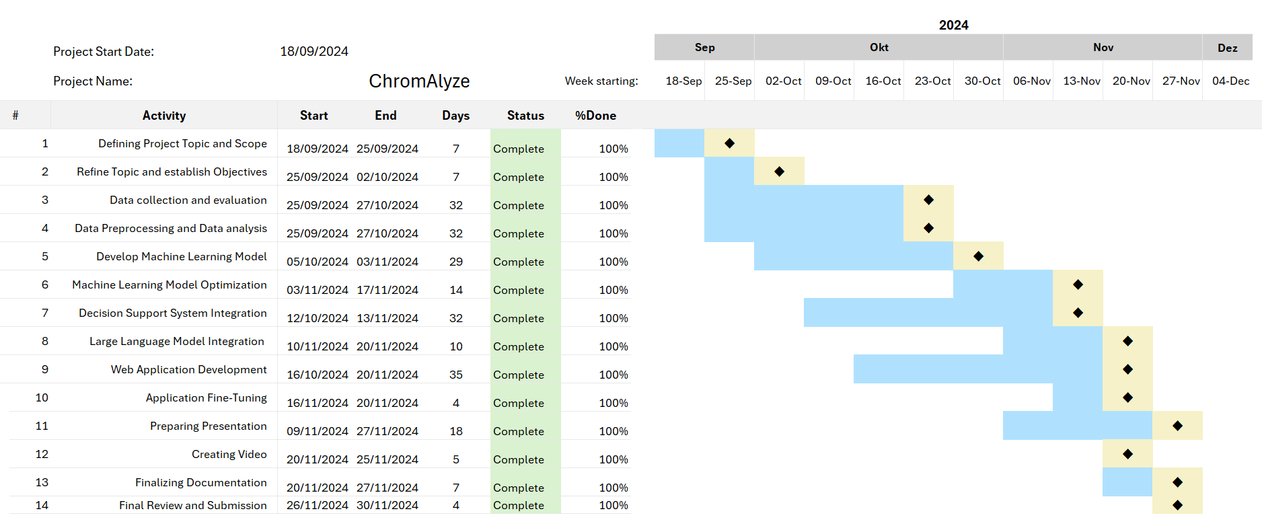
Timeline - Gantt

Slide 8




Vision: Empowering citizens
Guide
Evaluate
Educate
Recommend
Take control of your own health
Notes:
6. Vision
Objective: Present the long-term goals or potential evolution of the solution.
Key Points:
Future opportunities or expansions for the solution.
How could the problem evolve, and how will your solution adapt?
Potential partnerships, innovations, or scaling strategies.
Broader aspirations for impact in the domain.

